Slide 1
Beach Protection at Singer Island
Presentation to COASI
February 15, 2025

Slide 2
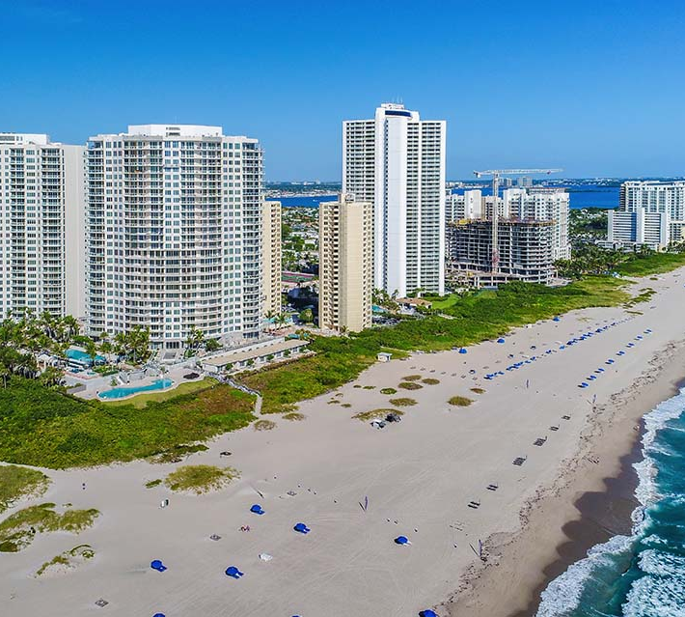
Agenda
History
SI Environmental Committee
Beach Protection Measures
Current Status
Next Steps

Slide 3
PBC Beaches Recognized as Critically Eroded
Problem:
Beach Erosion
Source: August 2024 Report by FDEP Office of Resilience and Coastal Protection
https://floridadep.gov/rcp/coastal-engineering-geology/documents/critically-eroded-beaches-florida

Slide 4
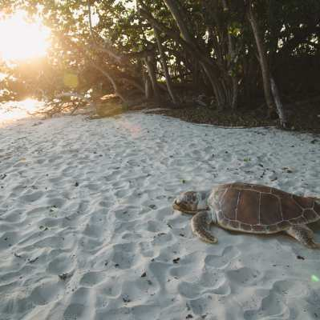
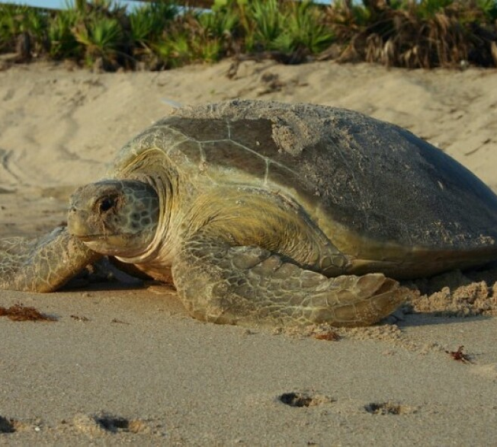
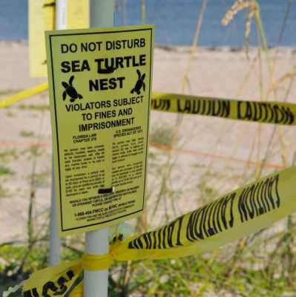
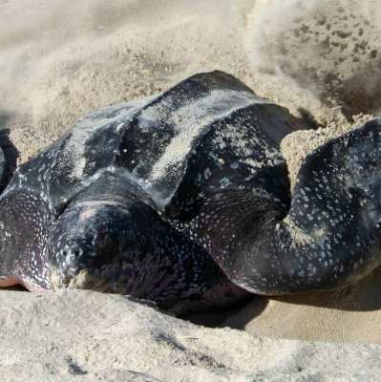
Nesting Sea Turtles Love Our Beaches!
Palm Beach County is a primary habitat in Florida for nesting season, March-October
MacArthur Park is epicenter
State takes turtle protection very seriously

Slide 5
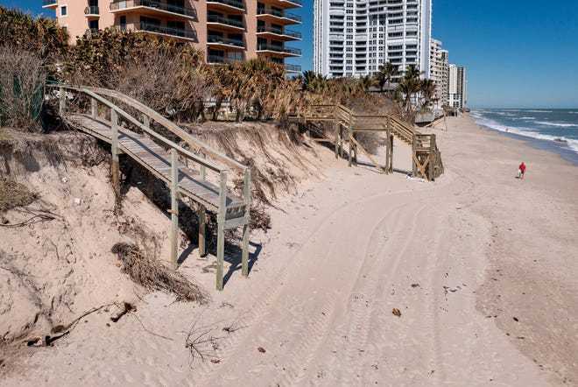
Prior Beach Protection Efforts
PBC study in 2006 recommended breakwaters over 1.2-mile length of Singer Island (mid to northern section)
Project was funded with $30M
Environmental organizations contested USACE findings of no effects on turtle migration
Rejected by FDEP in 2011 following court ruling
FDEP: Towns must jointly perform comprehensive study from Lantana to Jupiter Inlet to evaluate cumulative effects of breakwaters

Slide 6
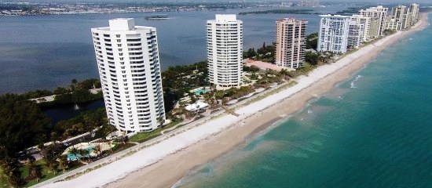
Public vs Private Beaches: Beach Replenishment
Private beaches don’t qualify for federal/state funding
Must have public access points
Must have parking lot every ½ mile
Must allow public use landward of MHWM
Only a few non-contiguous locations on Singer qualify
Replenishment remains a County responsibility

Slide 7

Singer Island Environmental Committee
Formed in March 2024 as a “grass roots” organization to address beach erosion and protection
Thanks to Julie Botel, Glen Spiritis, Frank Fernandez, and several condo representatives for their diligent efforts!
Consists of 30 members; 1-2 from each of 17 oceanfront buildings, Yacht Harbor Estates and Palm Beach Shores
Drafted petition for PBC and Riviera Beach to jointly fund and perform Feasibility Study
Submitted Petition in April 2024

Slide 8

Current Status for Feasibility Study
Joint funding approved October 2024 (75% County/25% City)
Foth Olsen coastal engineers retained to perform Feasibility Study
Scope of work includes coordination with FDEP and USACE to ensure acceptability of recommended solutions

Slide 9
Feasibility Study Scope (from Interlocal Agreement)
“A. Feasibility Study consists of analyzing the current and historical morphodynamic conditions of the beach and dune system within the Restoration Area, evaluating various potential management and restoration strategies, evaluating costs, and recommending a proposed alternative project methodology.
B. Components include data collection; research, technical evaluation, modeling of project design alternatives, and review of regulatory considerations; and the drafting of a written report to document the study methods and outcomes.”

Slide 10
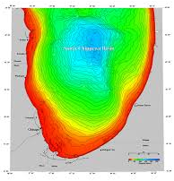
Factors Affecting Selection of Beach Protection Measures
Tides and Currents
Marine Habitat
Storm Frequency and Surge Heights
Ocean Bathymetry and Beach Topography
Presence and Location of Sea Wall
And of course, TURTLE MIGRATION AND NESTING!

Slide 11
Beach Protection Measures
Offshore: Attenuate Wave Energy
Breakwaters
Groins/Jetties
Seaweed Beds
Artificial Reefs
Onshore: Stabilize Dunes to Prevent Washout
Gabions/Rip Rap
Plantings
Woven mesh blankets

Slide 12
Other Measures
Seawalls
Beach Replenishment

Slide 13
Offshore Measures

Slide 14
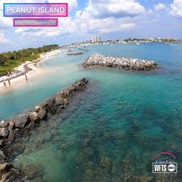
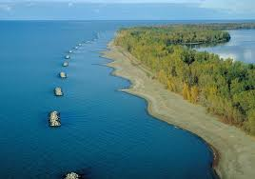
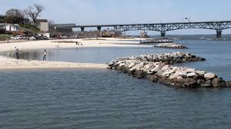
Breakwaters
Parallel to the Beach
Continuous or Segmented
Used at Peanut Island and other Florida beaches
Rejected for use at Singer Island by FDEP due to turtle migration

Slide 15
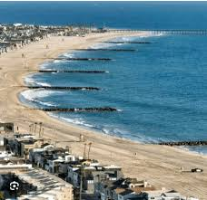
Groins and Jetties
Perpendicular to the Beach
Can be Solid or Pervious: wood, boulders, synthetic
Tend to accrete sand on one side while scouring on other side
Have not been permitted by FDEP in recent years

Slide 16
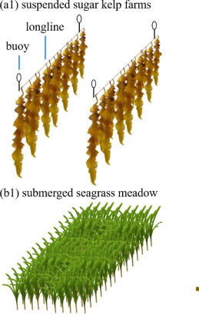
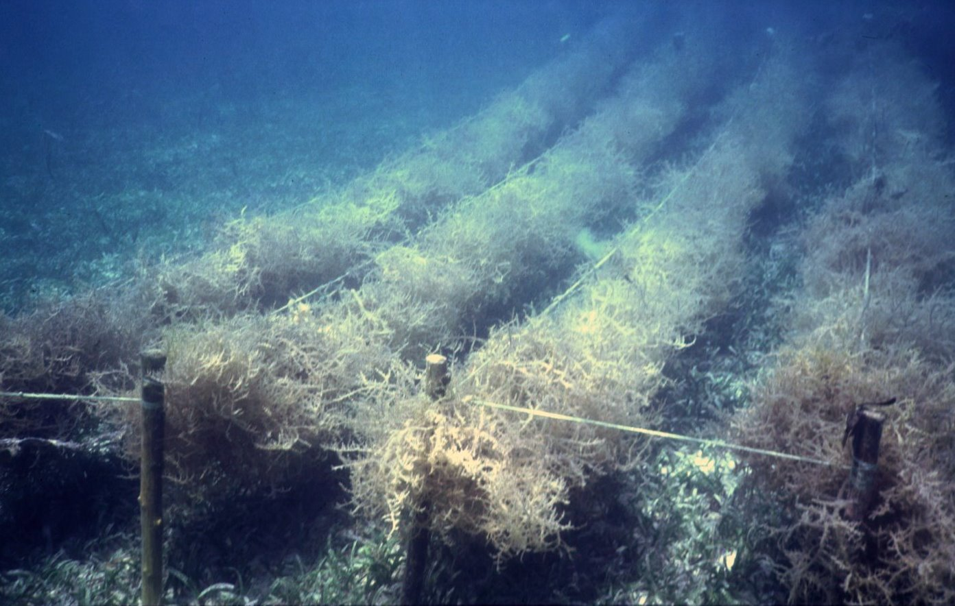
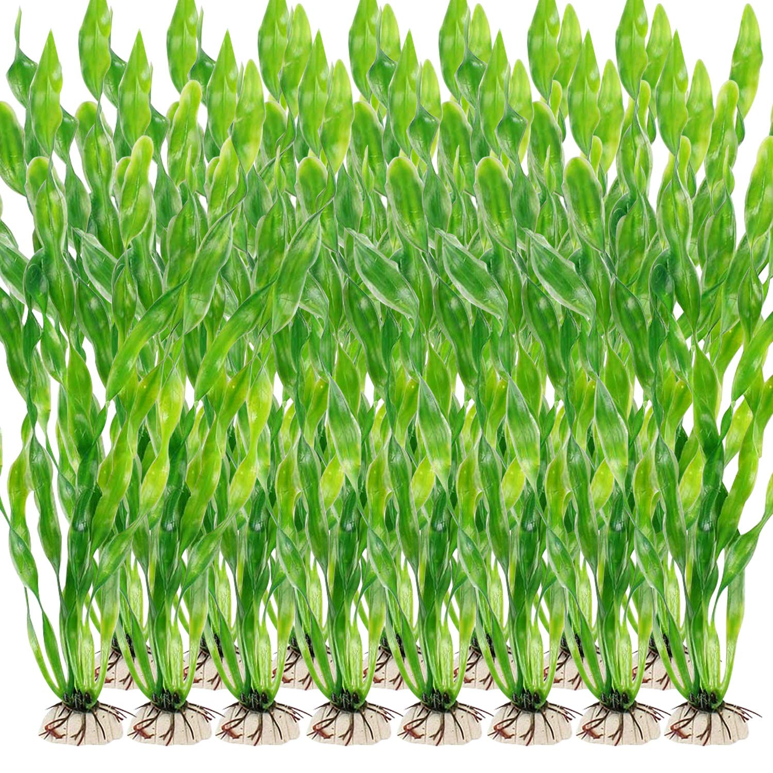
Seaweed Beds
Kelp Farming
Seagrass Meadows
Synthetic Seaweed
Anchored or suspended
Attenuate wave energy by about 30-50%
Being used since 1960s
Can impede turtle migration
Have been used in FL but require FDEP approval

Slide 17
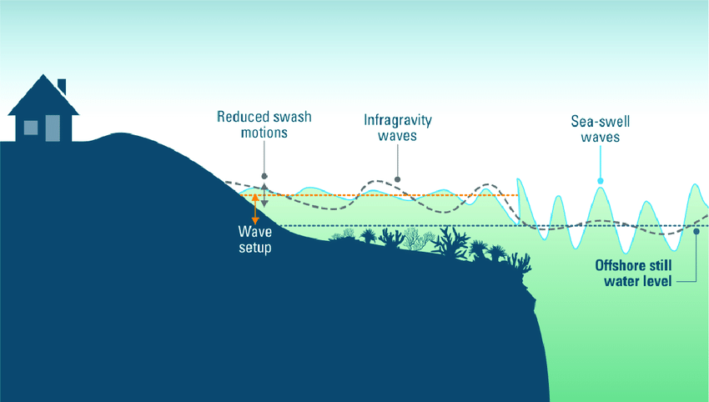
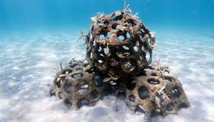
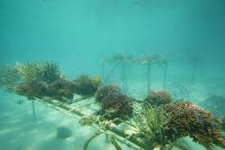
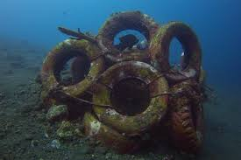
Artificial Reefs
Proven to attenuate wave energy
Can be constructed of a wide range of materials: tires, coral, shells, reefballs, etc.
Used throughout US and abroad

Slide 18
Onshore Measures

Slide 19
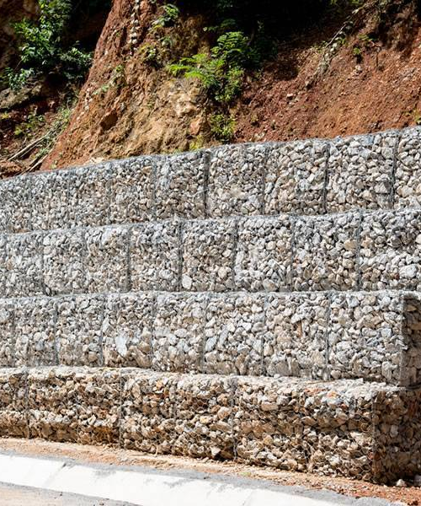
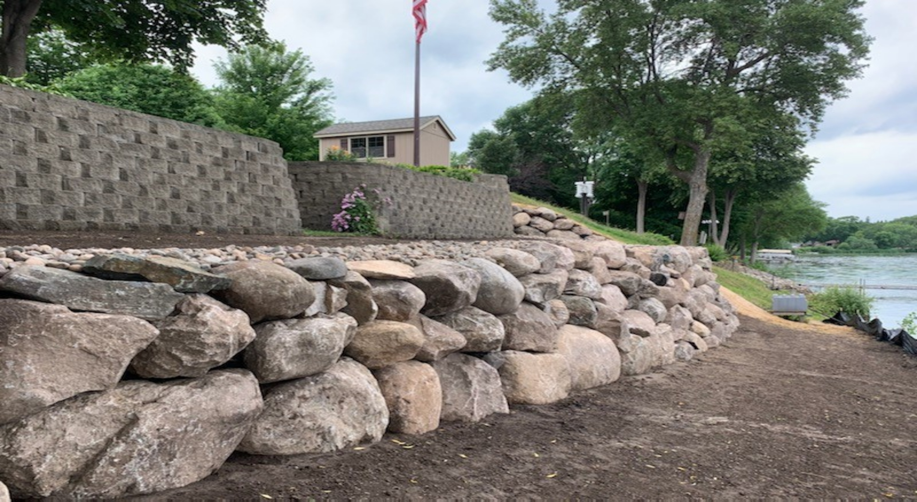
Used to reinforce dune, create berm or retaining wall
Can be layered or stepped
Hold sand and prevent washout
Construct upland to avoid turtle impacts
Gabions/Riprap

Slide 20
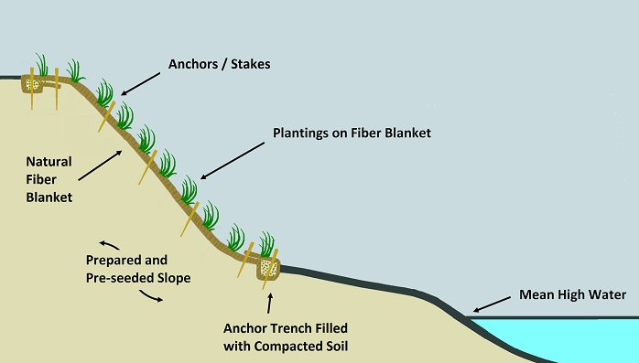
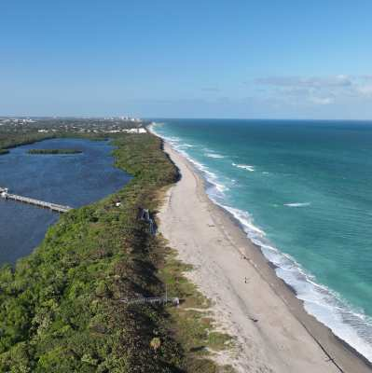
Plantings Can Be Used to Stabilize Dunes
Plantings along banks hold soil and sand together and prevent washout
Singer Island beaches are wider at southern end where planted areas separate buildings from the beach.
Macarthur State Park beaches demonstrate effect of lack of development

Slide 21
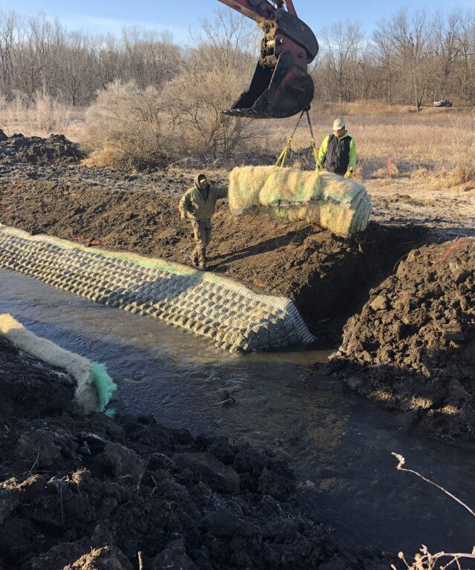
Woven mesh wraps and other materials for dune stabilization

Slide 22
Other Measures

Slide 23
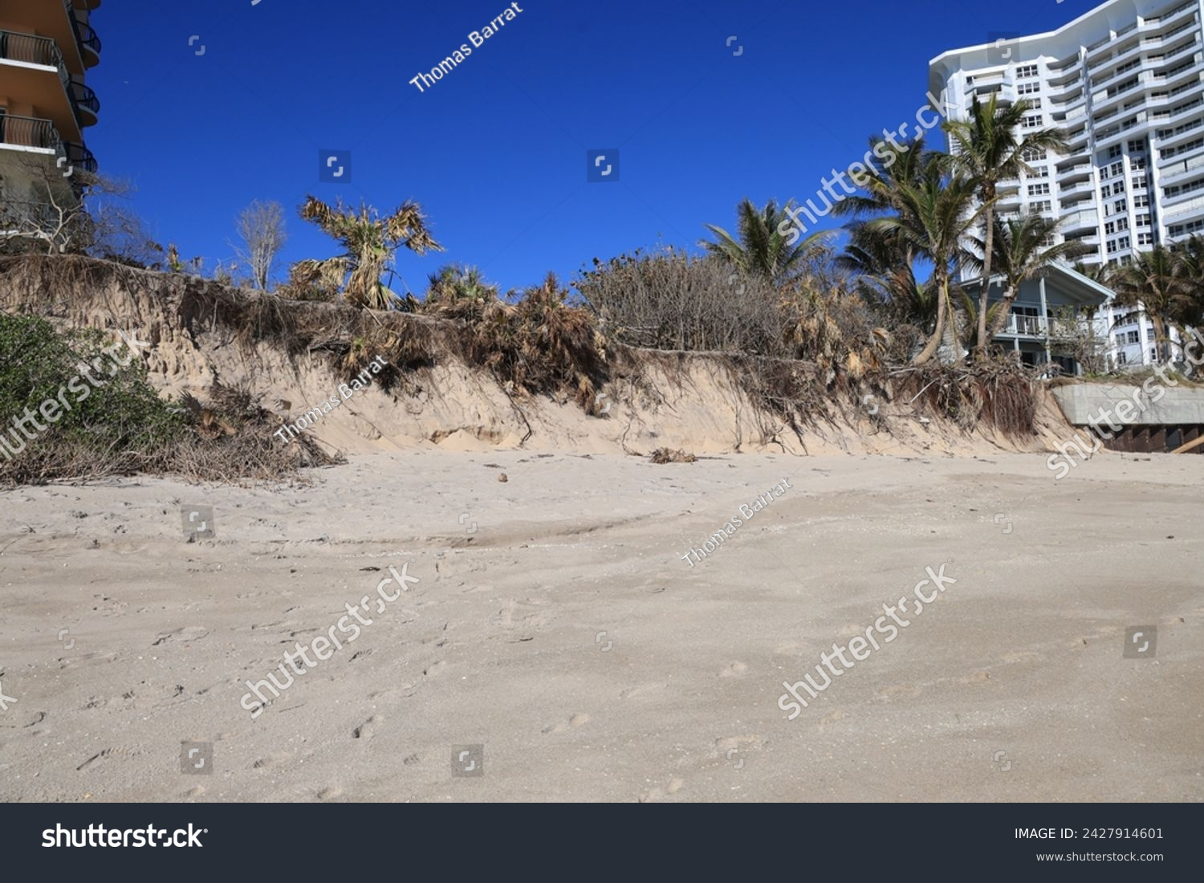
Seawalls
Not for beach protection!
Protect property and buildings from damage due to sea surge
Can contribute to scouring at base
Competing interests: beach width vs property protection vs turtle habitat

Slide 24
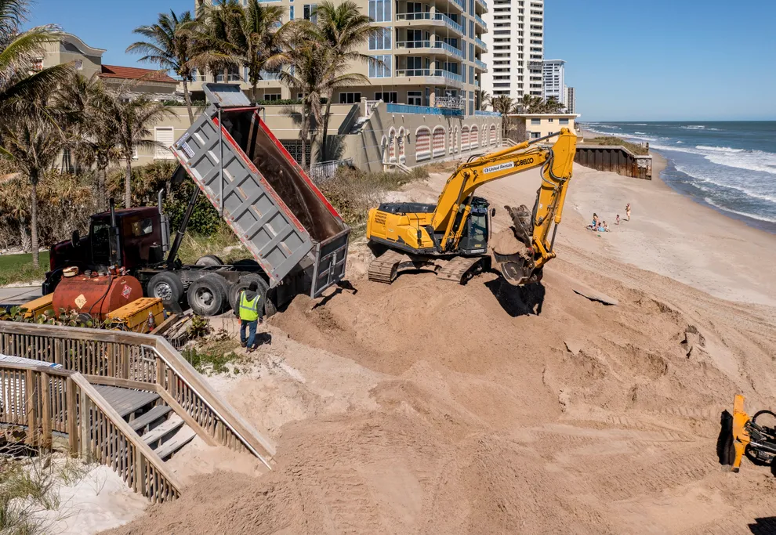
Beach Replenishment: A Temporary Fix
In 2023-2024, Palm Beach County had been replenishing public beaches and beaches without seawalls
Councilman Glen Spiritis spearheaded effort to garner County commitment for a 1.1-mile length along Singer Island
City and County signed 10-year agreement in October 2024
Cost share 80% County/20% City, except mid-island portion paid 50/50
City to provide up to $1M/year

Slide 25
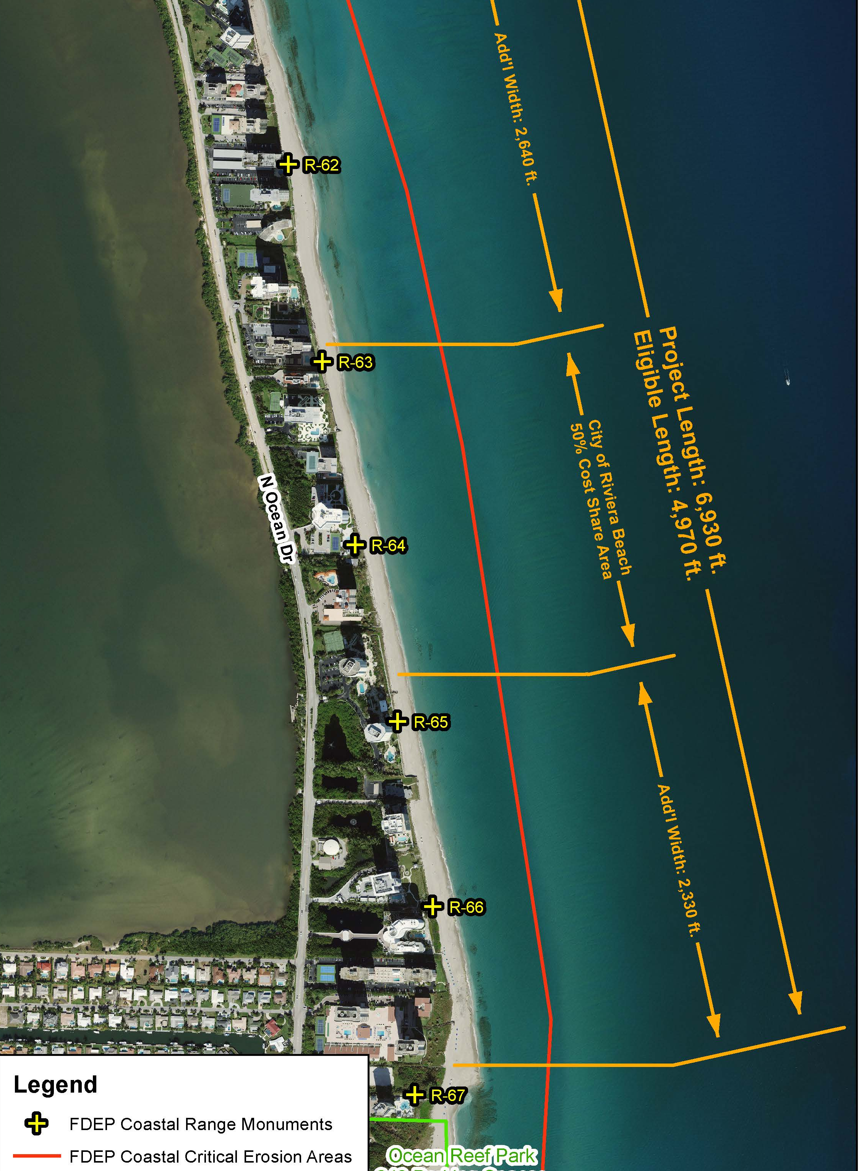
Beach Replenishment by Zone
Includes all Singer Island oceanfront buildings, with and without seawalls
Started at north end; now at Sea Grape
Awaiting completion of Eastpointe seawall

Slide 26
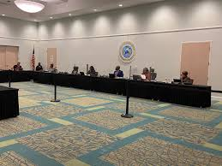
Next Steps
Attend public Riviera Beach and Palm Beach County meetings
Voice your concerns
Monitor progress for feasibility study
Results could take 8-10 years to implement, including Environmental Impact Analysis

Slide 27

SI Environmental Committee
Sue Melamud, Chair
suemelamud@hotmail.com
Frank Fernandez, Co-Chair

